Slide 1


Presentation to MFC CDT kick-off camp, University of Reading, 18th September 2024
Expert Prediction Markets for Climate Risks
Mark Roulston
Thanks to Kim Kaivanto, Todd Kaplan and Brett Day

Slide 2
Expert Prediction Markets for Climate Risks
The market for climate forecasts suffers from three major challenges: the fragmentation of relevant expertise, the information asymmetry inherent in long-range prediction when forecaster track records are not available, and the “circularity” of the interdependence between physical climate predictions and future greenhouse gas concentrations.
These three issues can be simultaneously and elegantly addressed using prediction markets. Prediction markets are similar to financial futures markets, or even sport betting, but instead of being designed to transfer risks, or for entertainment, they are specifically intended to elicit and aggregate disparate information.
Prediction markets have been used to predict things such as the outcomes of elections and the reliability of psychological research but attempts to use them for predicting climate have met with mixed results due to the low liquidity typically encountered by markets for specialized topics.
The liquidity problem can be tackled using automated market making algorithms and this approach will be illustrated with examples of successful climate-related prediction markets. How such markets can be used for long-range climate prediction, addressing the problem of circularity, will also be explained. An upcoming demonstration market for predicting Atlantic hurricane activity, in which university teams are invited to take part, will be introduced.

Slide 3



Three challenges for climate forecasting
Fragmentation: forecasting climate requires disparate expertise in physical and social sciences; different modelling approaches.
Information asymmetry: it can take decades to ascertain the quality of a forecaster; track records can’t be used to evaluate them.
“Circularity”: long-range climate forecasts are conditional on GHG emissions, which are conditional on policy, which is conditional on long-range climate forecasts.

Slide 4
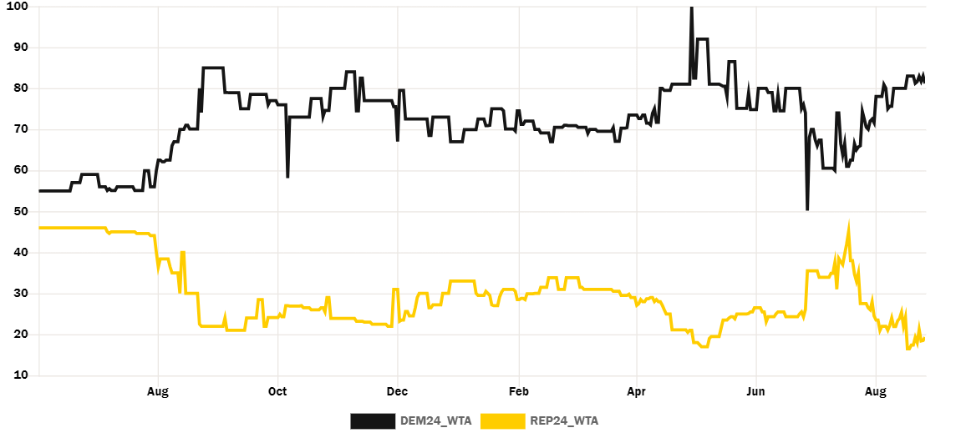
Prediction markets
Designed to obtain information, not transfer assets or risks.
Typically use “Arrow-Debreu securities” which pay out 1.00 if an event occurs and nothing if it doesn’t.
These are traded on an exchange and the prevailing price is an implied probability of the event.
Iowa Electronic Markets (IEM) have been running since 1980s, with a focus on politics.
IEM prices for 2024 U.S. Presidential election.

Slide 5
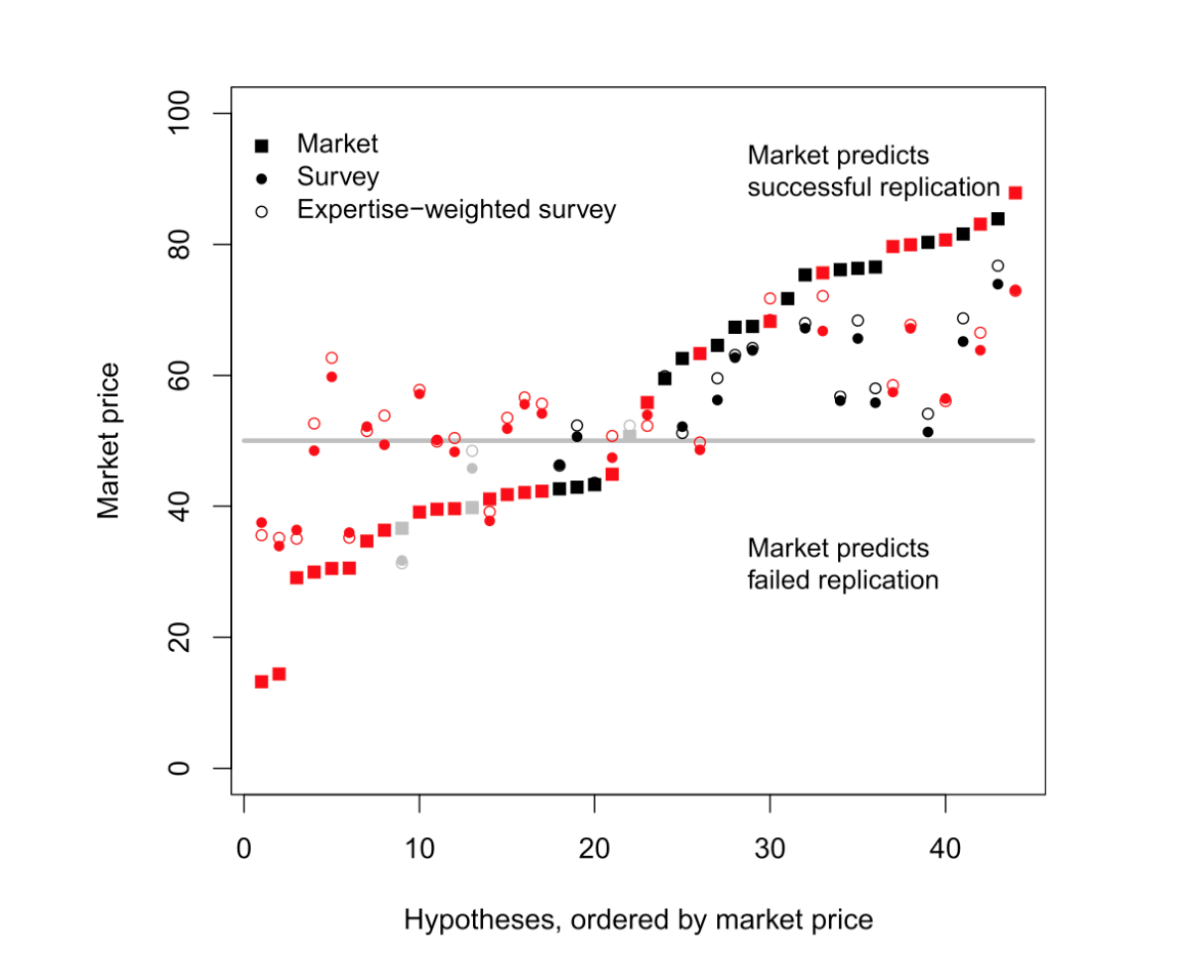
An expert prediction market to predict whether experimental psychology studies would replicate.
Prediction market approach found to outperform surveys.
Prediction markets “correct” in 71% of replications.
Simple average survey correct in 58% of replications.
Weighted average survey correct in 50% of replications.
Prediction market performance. Final market prices and survey predictions are shown for the replication of 44 publications from three top psychology journals. The prediction market predicts 29 out of 41 replications correctly, yielding better predictions than a survey carried out before the trading started. Successful replications (16 of 41 replications) are shown in black, and failed replications (25 of 41) are shown in red. Gray symbols are replications that remained unfinished (3 of 44).
Dreber, Anna, et al. "Using prediction markets to estimate the reproducibility of scientific research." Proceedings of the National Academy of Sciences 112.50 (2015): 15343-15347.

Slide 6
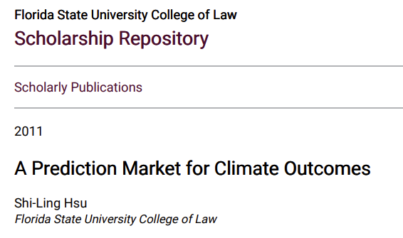
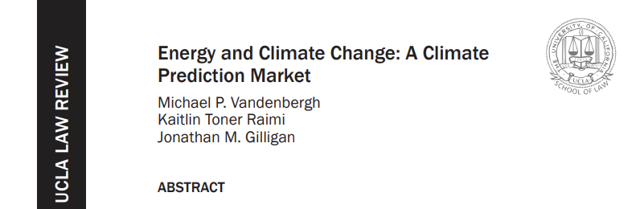
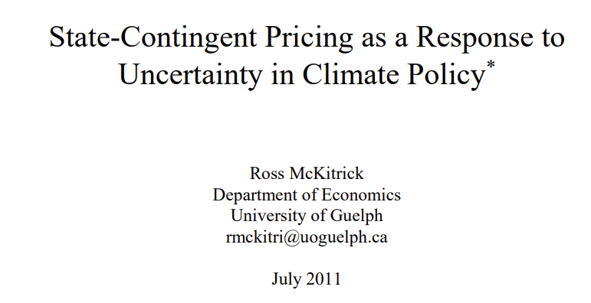
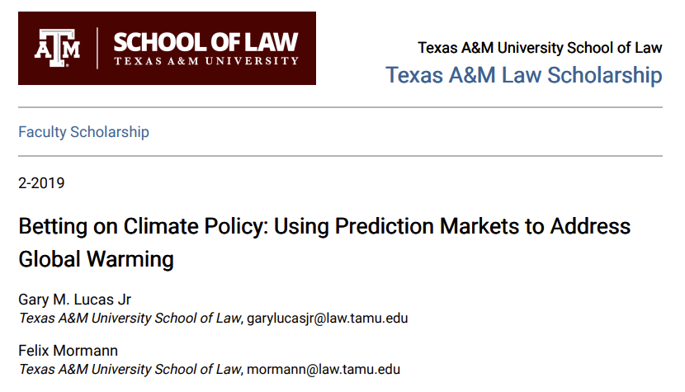
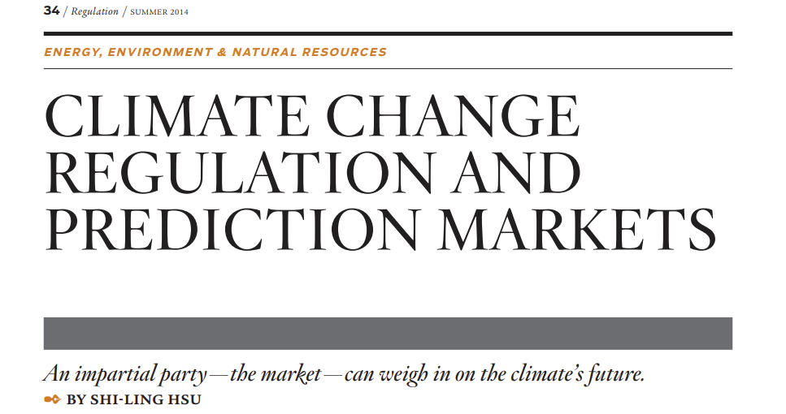
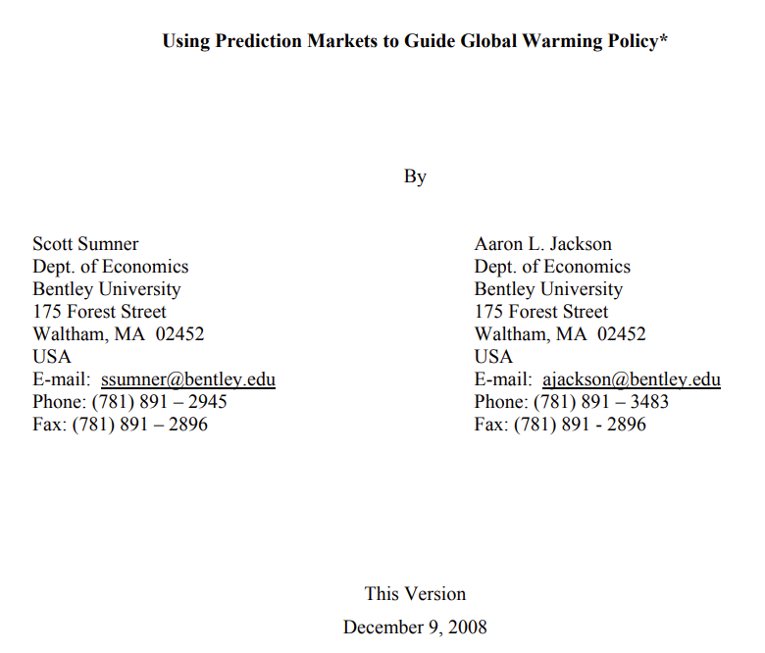
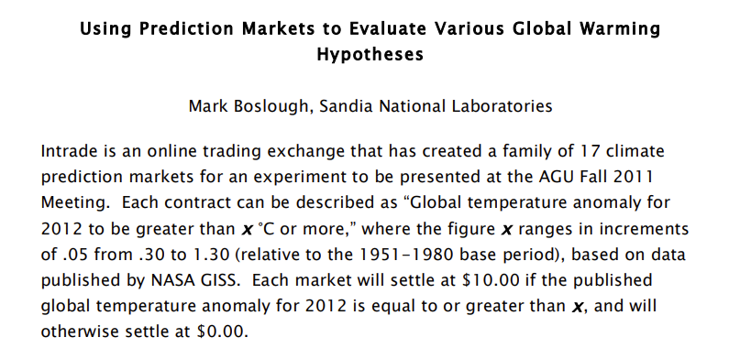
The idea of using prediction markets for climate is not new, but there have been obstacles.

Slide 7
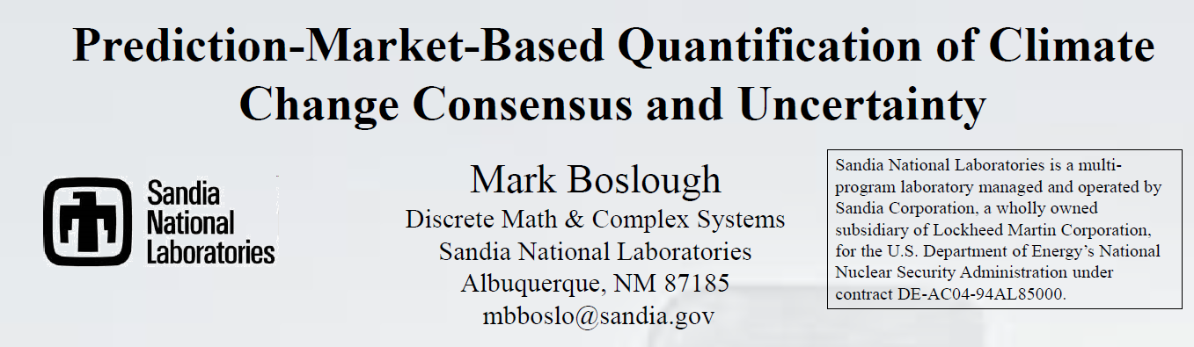
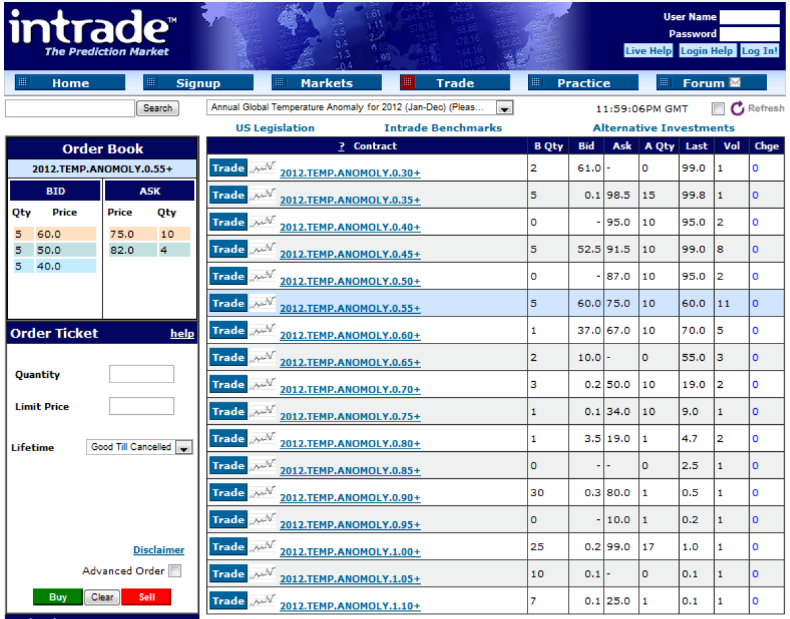
Early experiment with a prediction market for year ahead global temperature.
Temperature anomaly was partitioned into 0.05°C intervals.
Used the inTrade platform, with a continuous double auction.
Suffered from high “bid-ask” spreads and low volume: a.k.a. low liquidity

Slide 8
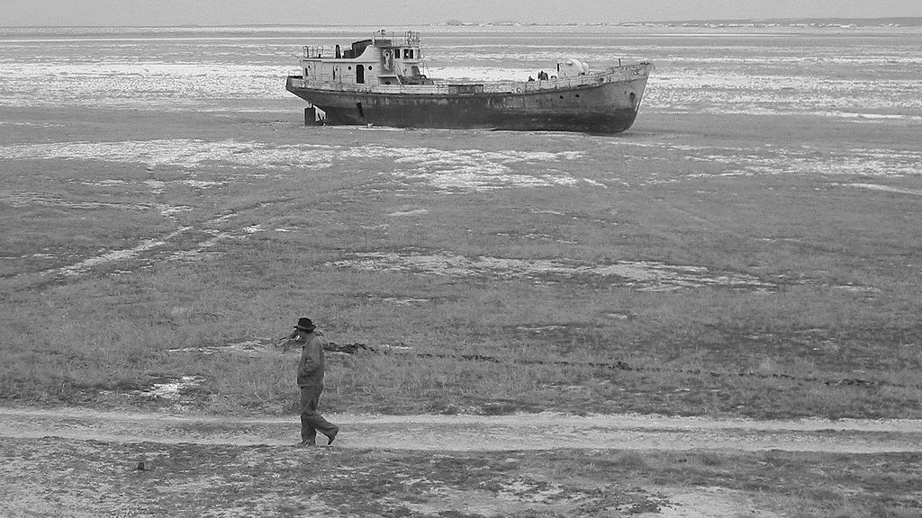
Overcoming the liquidity problem
Many prediction markets use continuous double-sided auctions.
Buyers are matched directly with sellers.
Rewards of informed participants come from losses of uninformed ones (zero or negative sum).
Uninformed (or unlucky) participants essential.
Failure to attract them causes low liquidity.
An automated market maker (AMM) will always trade.
Subsidised AMM will lose money for good information.

Slide 9
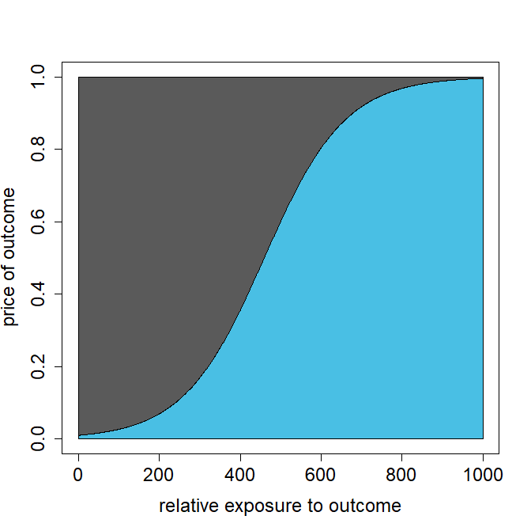
Logarithmic market scoring rule (LMSR)
Area above the curve is the net loss the market maker will suffer if the outcome occurs.
This area is bounded.
algorithmic market maker will always buy and sell outcomes
quotes prices based on its relative exposure
prices between 0.00 and 1.00.
market maker’s maximum net loss is bounded
rewards linear in the logarithmic score
Area under the curve is the amount the market maker receives for selling contracts.
Hanson, Robin. "Combinatorial information market design." Information Systems Frontiers 5.1 (2003): 107-119.
Notes:
5 minutes

Slide 10
Prediction markets and the law
“Pay-to-play” prediction markets are classed as gambling or futures markets.
IEM has a “no-action” letter from the CFTC; places limits on participants and stakes.
Smarkets is regulated by the UK Gambling Commission.
Kalshi is classed as a futures market, regulated by CFTC.
If markets are subsidised participants do not need to be a source of revenue, pay-to-play not necessary.

Slide 11
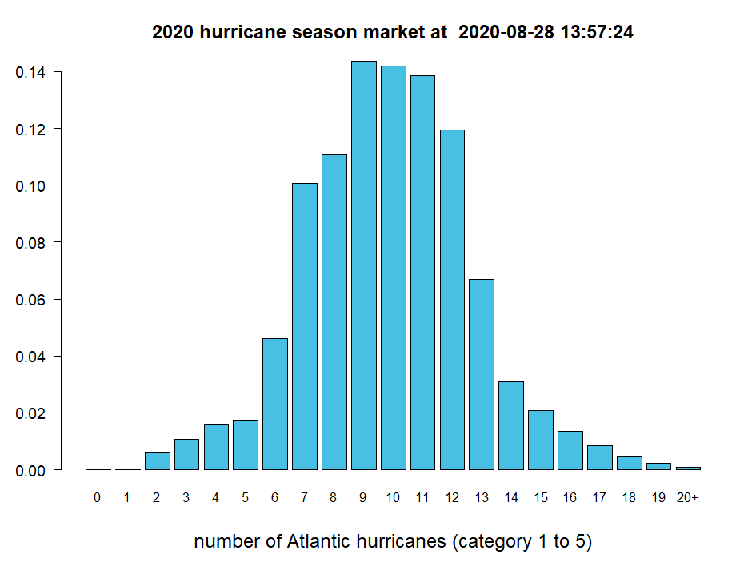


Example: hurricane activity 2020
Prices interpreted as probabilities: e.g., 3% chance of 14 hurricanes
Each prediction is divided into possible outcomes.
Each outcome has a price between 0 and 1 credit.
Participants are given credits to trade outcomes.
Participants can define contracts covering one or more outcomes.
AMM algorithm responds by adjusting prices.
When the outcome is known, it is worth 1.00 credit, all other outcomes are worth zero.
Prevailing prices can be interpreted as a probability forecast.
Each outcome has a price between 0 and 1 credit.
Each prediction is divided into possible outcomes.
Notes:
4 minutes

Slide 12
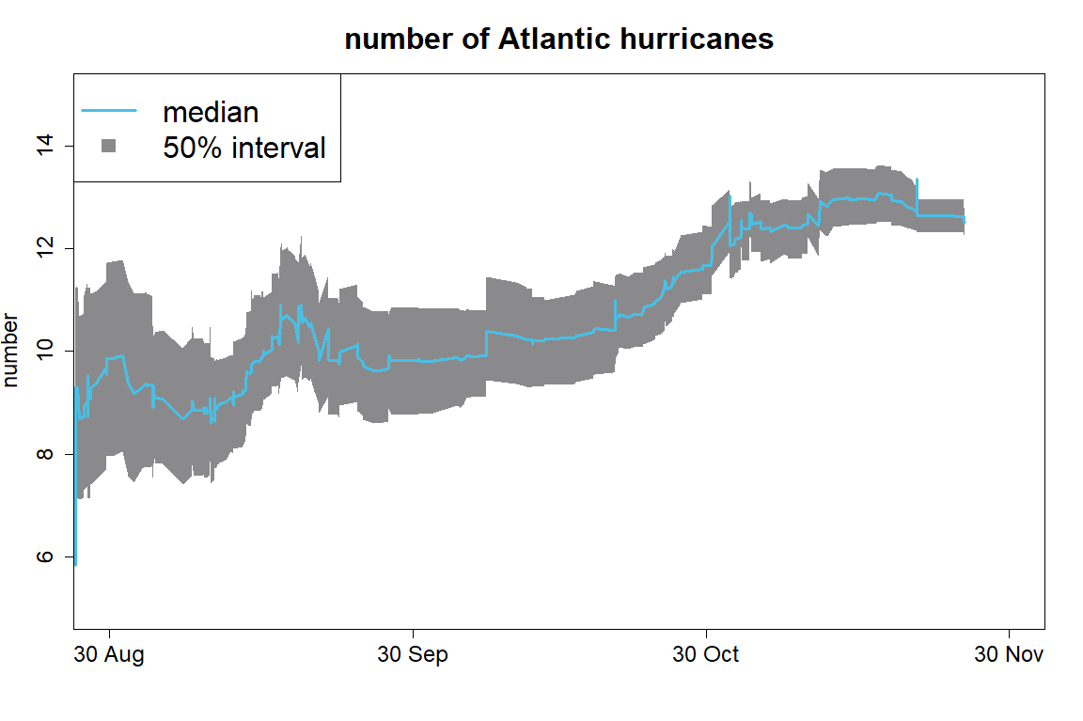
Proof-of-concept: Atlantic hurricane activity
market to predict number of Atlantic hurricanes during the 2020 season
part of Hivemind’s participation in Lloyd’s Lab Insurtech accelerator
participants had expertise in meteorology, data science, machine learning and statistics
historical average is 6 hurricanes
2 hurricanes had occurred when the market opened at the end of August
market initially predicted 9
2020 saw 13 storms classed as hurricanes by Nov 30*
*Tropical storm Gamma was upgraded in post-season analysis published in April 2021
Notes:
4 minutes

Slide 13
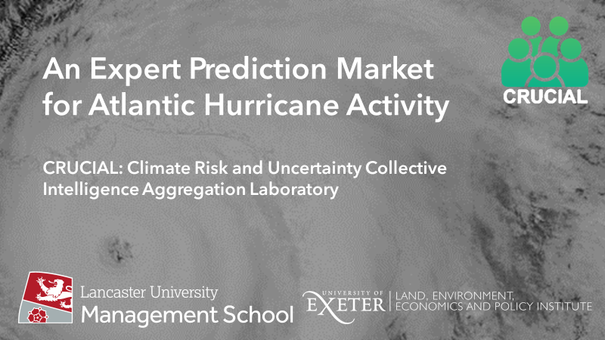
To predict number of Atlantic hurricanes that will occur during 2024 season.
Opened on December 1st 2023 and will trade through the season until November 30th 2024.
Not “pay-to-play”, invitation only.
£20,000 subsidy.

Slide 14
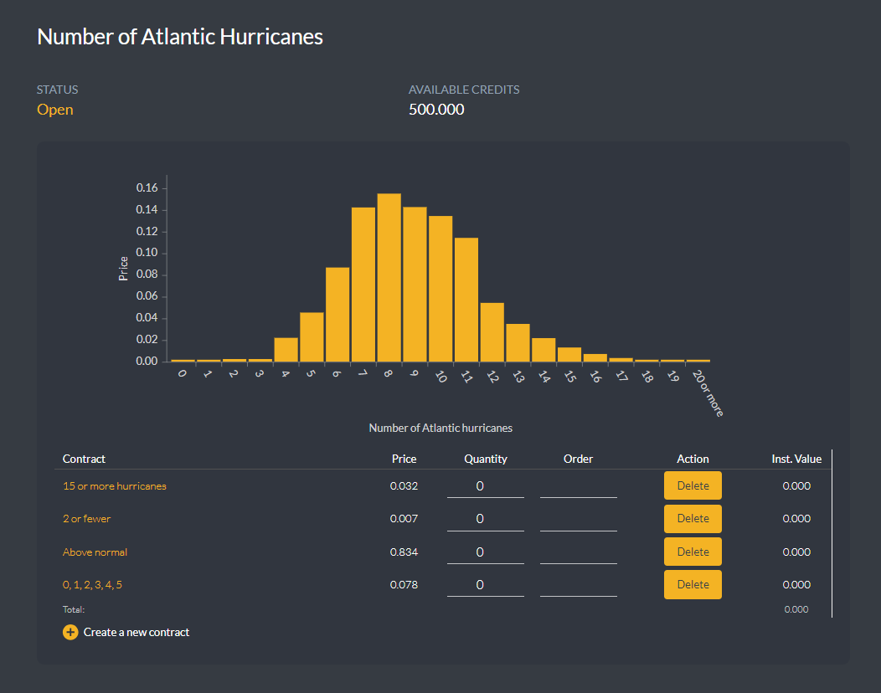
2024-09-15 07:00
Contracts covering multiple outcomes can be defined.
Prices set by the automated market maker.
https://agora.crucialab.net/

Slide 15
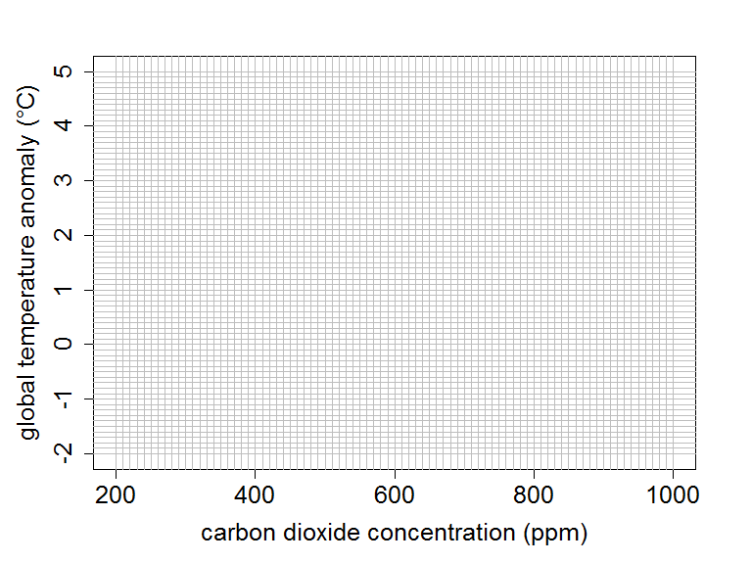
Solving the circularity problem
A temperature rise of 1.5°C is predicted:
Is this because…
climate sensitivity is low
or
big emissions reductions are expected?
a joint-outcome space for GHG concentrations and temperature can differentiate these possibilities
“Circularity problem” coined in the context of inflation forecasting: inflation depends on interest rates, which depend on predicted inflation.

Slide 16
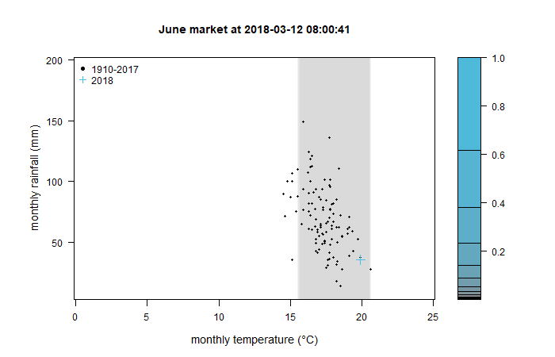

Proof-of-concept: monthly temperature and rainfall
simultaneous prediction of UK monthly temperature and rainfall
space divided into 5,207 outcomes (0.2°C x 5mm)
6 markets: April, May, June, July, August, September 2018
all markets opened in March 2018
24 teams from UK universities endowed with virtual credits
teams accumulating most credits received prizes totaling £55,000 (courtesy of Winton Group)
demonstrated viability of granular two-dimensional markets

Slide 17
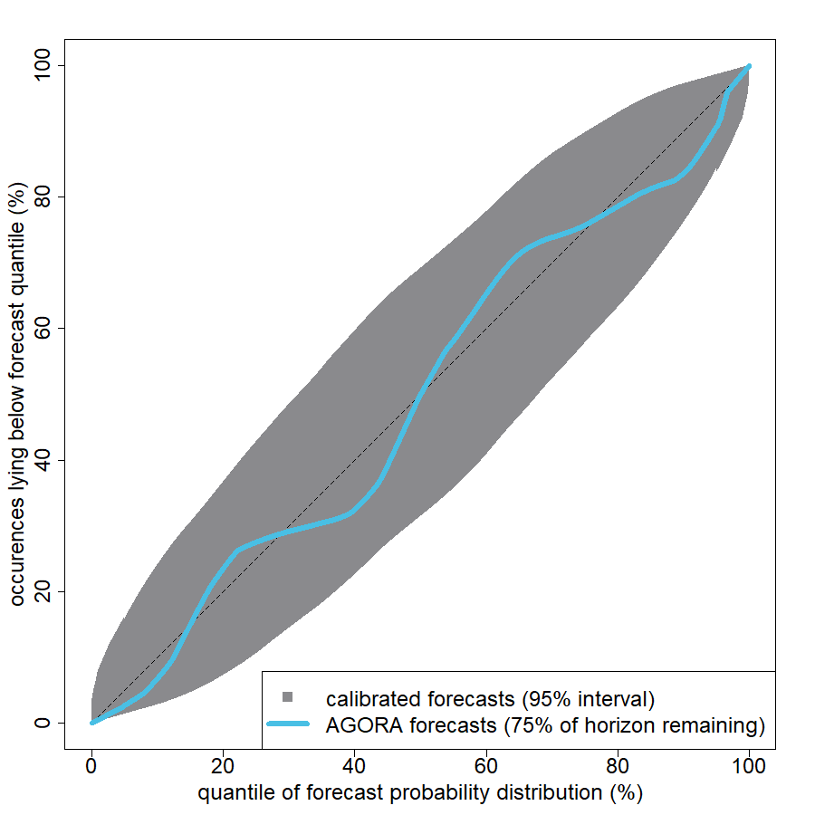

How accurate are market-based forecasts?
curves inside the grey envelope are consistent with perfect calibration
Risk forecasts should be calibrated: Frequencies of outcomes should match predicted probabilities.
Prediction market forecasts for climate risks made using expert participants are consistent with good calibration.
Calibration curve is for 24 predictions of climate-related variables made on the AGORA platform by participants with expertise in climatology, meteorology, statistics, crop science and data science. The predictions were for Atlantic hurricane numbers, tropical Pacific sea-surface temperatures and monthly temperature and rainfall for the U.K. and U.K. wheat yield. Forecast horizons ranged from 1 to 10 months. The grey envelope was generated from an ensemble of simulated “actual” occurrences drawn from the predicted probability distributions.
Notes:
4 minutes

Slide 18
Challenges faced by long-range markets
1. Time value of money
Denominate the market in an asset that accrues interest.
e.g., credits represent a share of an invested research endowment.
2. Stability and longevity of institutions
Participants need confidence market operator will be around for decades.
Funds held in a bankruptcy-protected trust.
Specified wind-up procedures.
3. Effectiveness of incentives on decadal horizons
Participation of institutions with longer horizons than individuals.
Work-place pensions rely on deferred incentives.

Slide 19
A new kind of scientific institution…
…that combines the concept of incentive prizes (e.g., Longitude Prize, X-Prize) with the information discovery of markets.
When the primary deliverable of research is a forecast, subsidised prediction markets can raise the productivity of researchers by providing a more efficient way to…
…aggregate and summarise disparate expertise.
…allocate funding.

Slide 20
Further reading
Roulston, M., Kaplan, T., Day, B. and Kaivanto, K., 2022. Prediction-market innovations can improve climate-risk forecasts. Nature Climate Change, 12(10), pp.879-880. https://doi.org/10.1038/s41558-022-01467-6
Roulston, M. and Kaivanto, K., 2024. Can expert prediction markets forecast climate-related risks?. Bulletin of the American Meteorological Society. https://doi.org/10.1175/BAMS-D-24-0135.1
Roulston, M. and Kaivanto, K., 2024. Joint-outcome prediction markets for climate risks. PLOS ONE. https://doi.org/10.1371/journal.pone.0309164
Notes:
4 minutes

